Slide 1
Lesson 1
Course Overview
&
Introduction to Space Systems Engineering

Slide 2
Course Overview

Slide 3
Course Overview
Fundamentals of space vehicle design are presented with an emphasis on systems engineering:
Introduction to system-level spacecraft design issues.
Introduction to and analyses of various spacecraft subsystems.
The course includes an integrated lab experience where small teams develop, analyze, and integrate subsystems into a functioning engineering model satellite.

Slide 4
Course Overview (cont.)
Course structure
34 class days
16 Lessons
12 Lab days
Field trip
Astro lab tour / Vibration Test Demo
2 GR’s
2-day final
Teams Channel
Course Handbook
Syllabus
Course Textbook
Equation Sheet

Slide 5
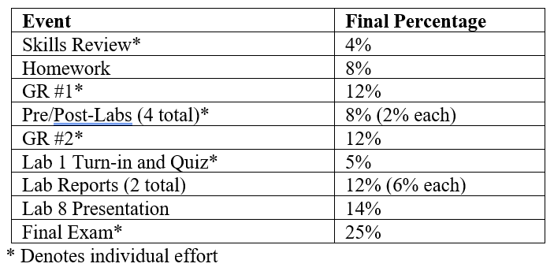
Graded Events
39% Labs
49% GR’s & Final
12% HW & Skills Review

Slide 6
331 Labs
Heritage of Astro 331 classroom satellite trainers
EyasSat
FlatSat
KestrelSAT
8 Labs:
Lab 1: Introduction to Embedded Systems (Individual Effort)
Lab 2: Soldering
Lab 3: Electrical Power Subsystem
Lab 4: Communication Subsystem
Lab 5: Remote Sensing
Lab 6: Attitude Determination
Lab 7: Attitude Control
Lab 8: KestrelSAT Capstone

Slide 7
Course Admin
Missing class
Assignments still due on time
Field trip date
Generative AI
Course updates this semester
Labs
Groups?
Pre/Post-labs (individual effort)
Lab reports (1x group turn-in)

Slide 8
Upcoming Graded Events
Skills review
Due start of Lesson 3
Lab 1
Beginner Kit
Lab Instructions
Tasks 0A/0B/0C complete by start of Lesson 4
Lab 1 due + Lab 1 Quiz on Lesson 6

Slide 9
Status
Where we’ve been
Where we are
Where we’re going

Slide 10
Introduction to Space Systems Engineering

Slide 11
What is a System?
A system is an arrangement of parts or elements that together exhibit behavior or meaning that the individual constituents do not.
Systems can be either physical or conceptual, or a combination of both.

Slide 12
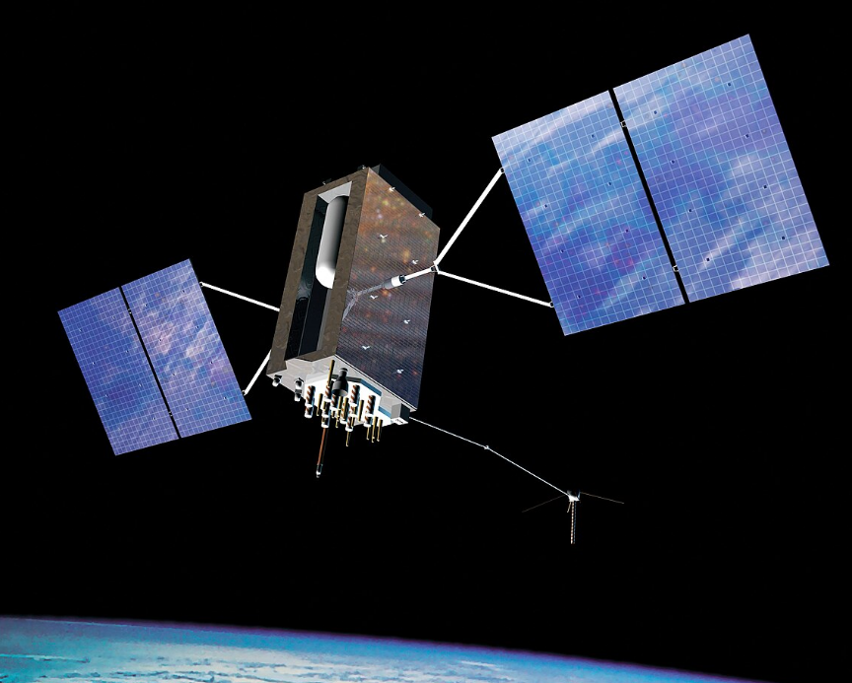
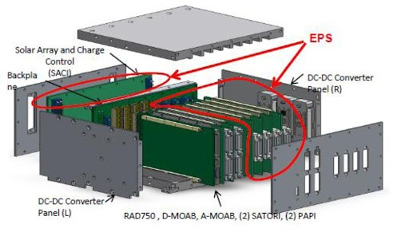
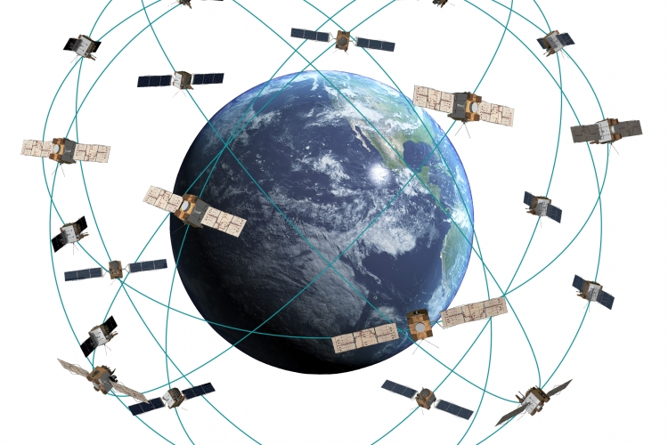
System Examples
Spacecraft as a system
Avionics as a system
Spacecraft constellation as a system

Slide 13
Spacecraft Subsystems Review
Bus:
Electrical Power Subsystem (EPS)
Communication and Data Handling Subsystem (CDHS)
Attitude Determination and Control Subsystem (ADCS)
Thermal Control Subsystem (TCS)
AKA Environmental Control and Life Support System (ECLSS)
Propulsion Subsystem
Structure
Payload

Slide 14
Systems Engineering
Systems Engineering deals with designing and managing complex systems. It has many different definitions, but most definitions tend to have several common themes:
Top-down approach
Defined Development Cycle
Defined Requirements
Interdisciplinary

Slide 15
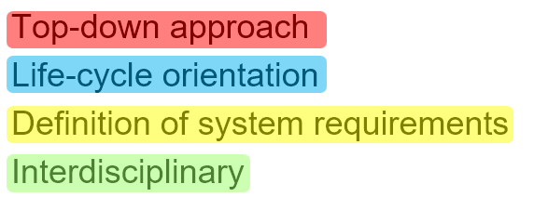
Definition of Systems Engineering
International Council on Systems Engineering (INCOSE):
An interdisciplinary approach and means to enable the realization of successful systems. It focuses on defining customer needs and required functionality early in the development cycle, documenting requirements, then proceeding with design synthesis and system validation while considering the complete problem: operations, performance, test, manufacturing, cost & schedule, training & support, and disposal. Systems Engineering integrates all the disciplines and specialty groups into a team effort forming a structured development process that proceeds from concept to production to operation. Systems Engineering considers both the business and the technical needs of all customers with the goal of providing a quality product that meets the user needs.
https://www.incose.org/
Notes:
The goal of all Systems Engineering activities is to manage risk, including:
The risk of not delivering what the customer wants and needs
The risk of late delivery
The risk of excess cost
The risk of negative unintended consequences

Slide 16
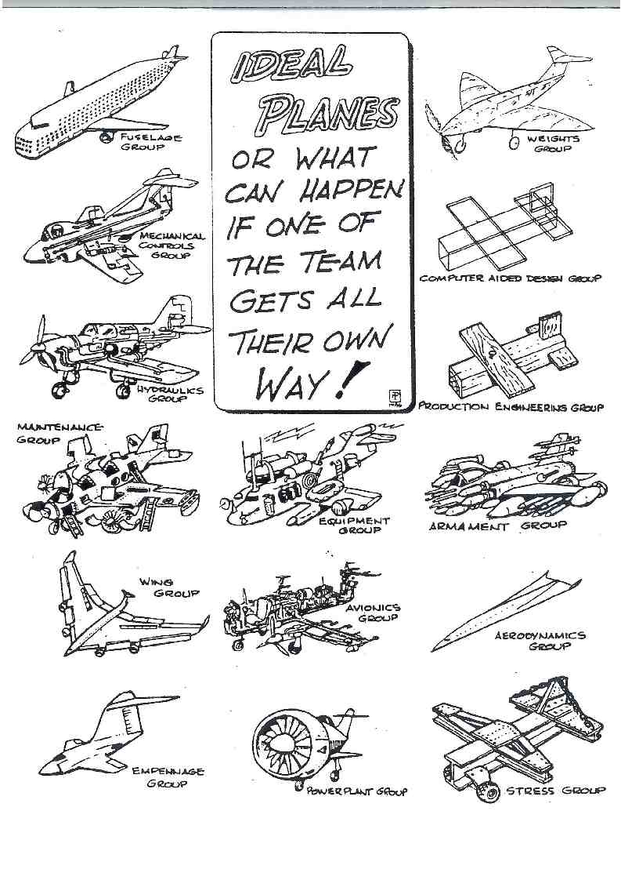
“Best” Designs If Each Team Gets Their Way
Systems engineering is a holistic approach that considers what design choices are best for the system as a whole, not just one segment.
Notes:
The best SYSTEM is the sum of the best SUBSYSTEMS
Compromises must be made in each subsystem to optimize the overall system.

Slide 17
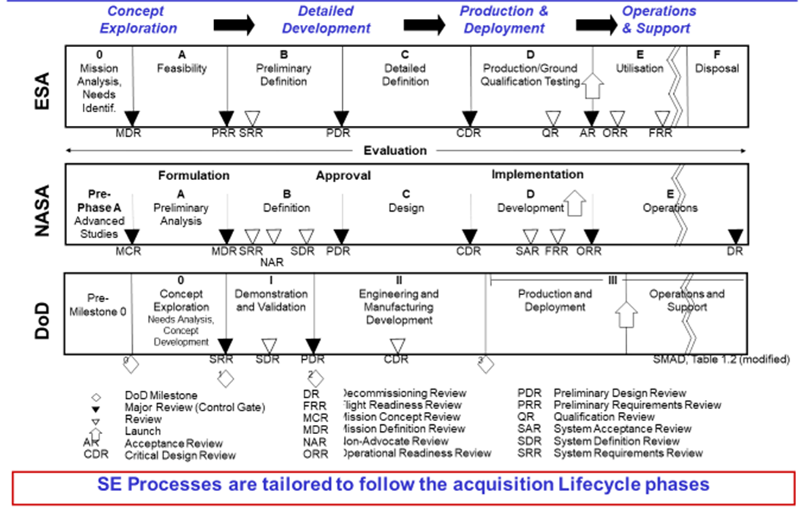
Example Space Mission Lifecycles

Slide 18
Lifecycle: Core Concepts
Develop Concept
Design & Develop System
Produce System
Deploy System
Operate System
Retire System
Need
Conceptual Design
Preliminary Design
&
Detail
Design

Slide 19
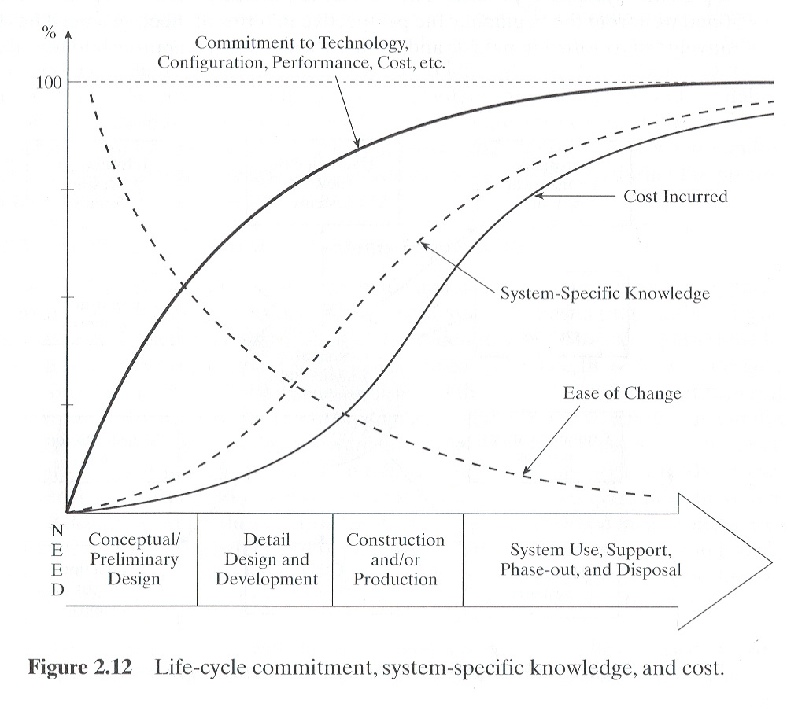
Life Cycle Commitment, System Specific Knowledge, & Costs
Commitment to an approach builds rapidly
Significant life cycle cost is incurred late
Knowledge of the system lags behind commitment to approach
Change is easiest early in lifecycle
So, what do you conclude?

Slide 20
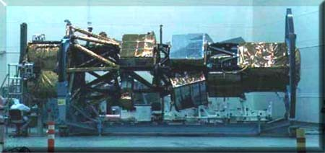
Example of SE Failure
Future Imagery Architecture - FIA - a $5 billion (award) spy satellite system was behind schedule and expected costs to complete were $13 billion over budget.
The optical satellite system of FIA was canceled in 2005 after 6 years and spending more than $4 billion.
“ … (a) factor was a decline of American expertise in systems engineering, the science and art of managing complex engineering projects to weigh risks, gauge feasibility, test components and ensure that the pieces come together smoothly.” NYT, 11/11/07
“Perhaps the most spectacular and expensive failure in the 50-year history of American spy satellite projects."
Notes:
Here are the top reasons why the Future Imagery Architecture (FIA) program failed, based on declassified sources, expert analyses, and retrospective reporting on the project:
1. Over-ambitious and immature technical requirements FIA was intended to leapfrog existing reconnaissance satellites by combining advanced optical and radar imaging on a single platform with capabilities beyond the state of the art at the time. However, many of these technologies were not sufficiently mature when development began, making the requirements essentially unachievable with available technology. The program’s design was so complex that engineers reportedly concluded parts of it could not be built as specified. (Wikipedia)
2. Contractor inexperience with key technologies When Boeing was awarded the prime contract in 1999 (beating Lockheed Martin, the long-time defense satellite builder), it brought forward highly innovative but high-risk designs for the optical component despite having limited experience building advanced electro-optical reconnaissance systems. This contributed to technical missteps and systems that did not perform as intended. (WIRED)
3. Significant cost overruns and budgeting issues FIA’s costs escalated rapidly. What was originally budgeted in the $5–7 billion range reportedly ballooned — some estimates suggested totals approaching $10–$18 billion when accounting for overruns and sunk costs. Cost growth eroded confidence in the program and strained related intelligence budgets. (Center for Public Integrity)
4. Schedule delays and slipping milestones The program repeatedly missed development and launch milestones. Delays were chronic and contributed to concerns about capability gaps in U.S. reconnaissance if older satellite systems began failing before replacements were ready. (Lexington Institute)
5. Management shortcomings and misaligned acquisition strategy Investigations and industry criticism highlighted contract and program management weaknesses, including selecting an overly ambitious production path, insufficient oversight of contractors, and embracing radical design proposals without adequate risk mitigation. A review panel reportedly described the program as “underfunded, technically flawed and not executable.” (Lexington Institute)
6. Cancellation of critical components By 2005, persistent issues led the Director of National Intelligence to cancel the optical component of FIA entirely. Only parts of the radar imaging portion — later referred to as Topaz — continued in a modified form. This represented a de facto program termination of the original integrated vision. (Wikipedia)
7. Loss of institutional confidence and political support The cumulative effect of cost growth, technical failure, and delays diminished confidence among policymakers and within the Intelligence Community. Congress and intelligence leaders became skeptical of FIA’s ability to deliver, influencing funding decisions and broader strategic shifts in reconnaissance acquisition. (The Space Review)
8. Parts-level quality and integration failures Reporting on affected hardware (e.g., related satellites like USA-193) highlighted defective parts and integration problems that compounded development difficulties. These issues slowed progress and increased costs. (WIRED)
Summary: FIA’s failure was not due to a single flaw but rather a combination of unrealistic technical goals, immature innovation risk, contractor and program management weaknesses, escalating costs, repeated delays, and loss of strategic support. In many respects it became a textbook case of trying to achieve “too much, too soon, without a realistic risk-reduction path” in a complex and high-stakes defense acquisition environment.
If you want, I can provide a chronological timeline of FIA’s development and cancellation or a comparison with the subsequent Next Generation Electro-Optical (NGEO) program.

Slide 21
Conclusion
Goal of Space Systems Engineering is to generate a product that:
Wholistically considers all aspects of the space mission
Spacecraft
Launch
Operations
Ground segment / end-user
Disposal
Meets mission requirements
On time
At an acceptable cost
At an acceptable level of risk

Slide 22
Extra Material

Slide 23
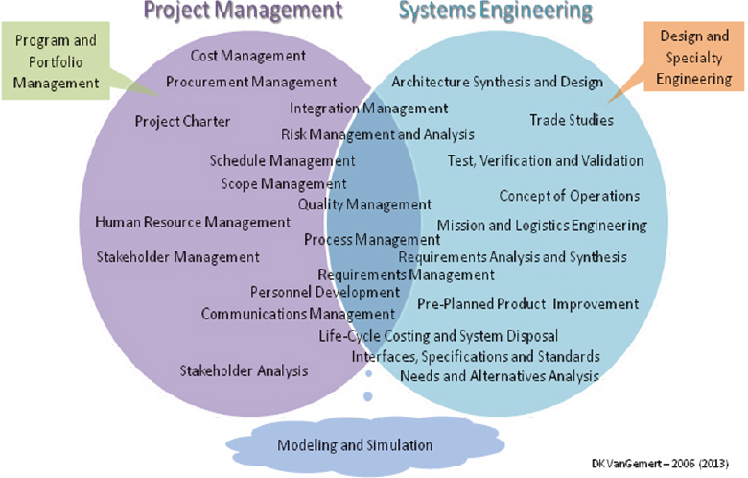
Sys Engineering vs. Project Management
Project management and systems engineering inter-relationship
Notes:
https://www.pmi.org/learning/library/systems-engineering-project-5857

